Slide 1

RI State Police
Financial Crimes Unit

Slide 2
Rhode Island State Police
Financial Crimes Unit
Sgt. Matthew Salisbury
Cpl. Anthony Commendatore
Det. James Brown, Esq., CFE
Det. Courtney Elliott, CFE
Det. Conor O’Donnell
Inv. Gerard Ratigan, Esq., CFE
Inv. Lori A. Tellier, CPA, CFE
CCC Karen Soderi
Notes:
7 detectives – one on assignment and one on leave
2 investigators
1 analysts assigned to us from the National Guard
1 Criminal Case Analyst – to manage us all!

Slide 3
Financial Crimes Unit
Financially motivated crimes such as embezzlement, obtaining money or property under false pretenses, identity theft, fraudulent use of a credit card, Elder Exploitaion, etc….
Politically motivated crimes such as bribery, extortion, bid rigging, etc.
Notes:
FCU came to be in 1993 due to the RI Banking Crisis. There was a need for a specialty unit to focus on financial crimes and to be trained to investigate

Slide 4
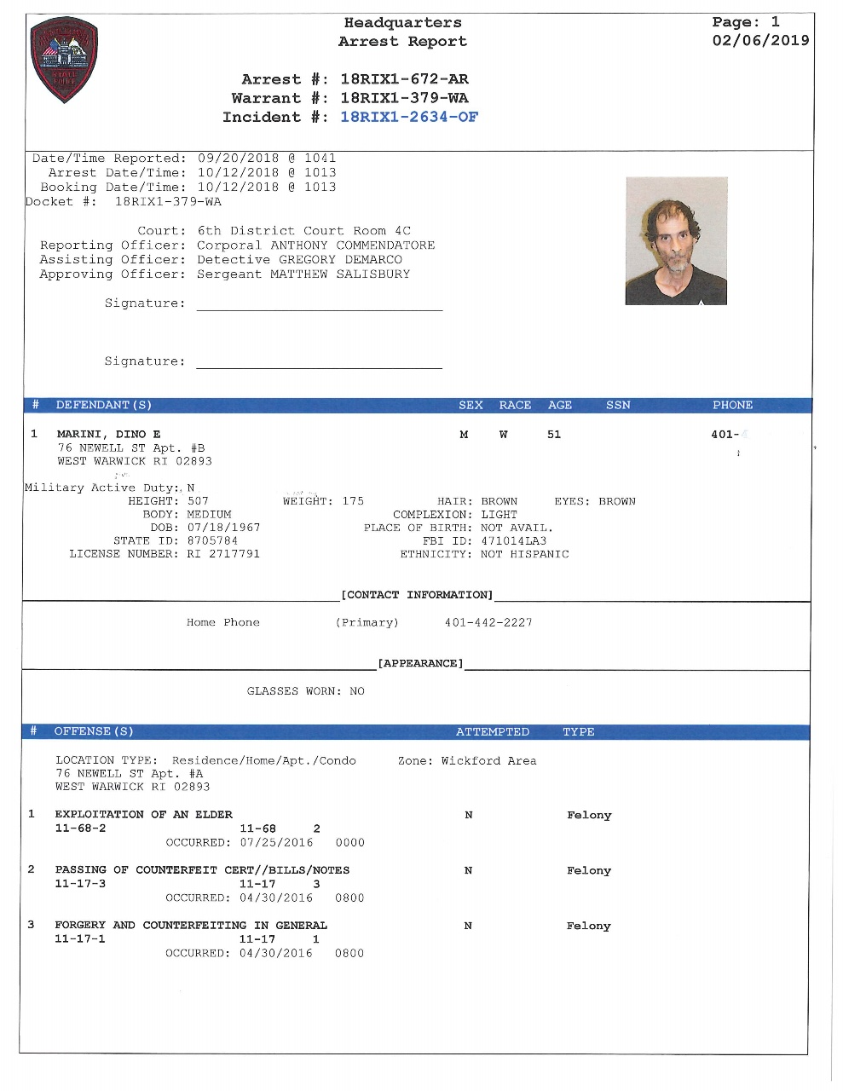
CASE STUDY

Slide 5
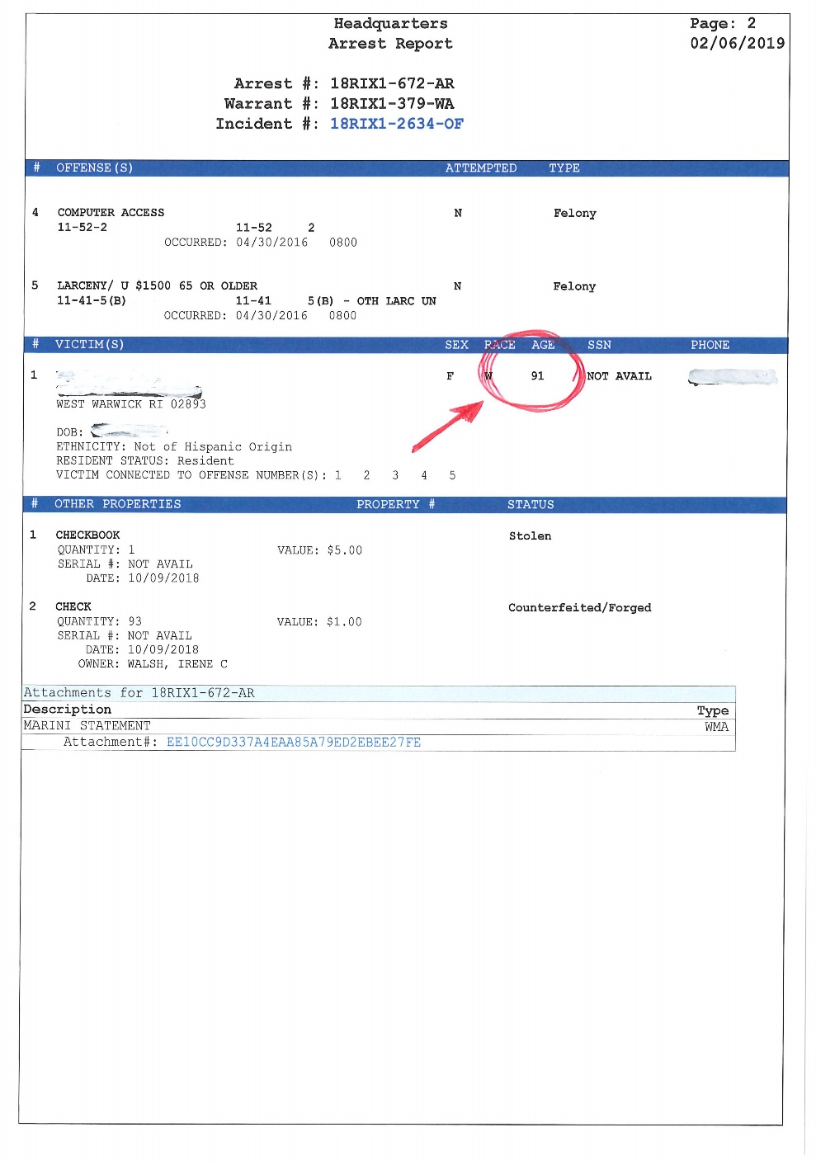

Slide 6
Locard's exchange principle
In forensic science, Locard's exchange principle holds that the perpetrator of a crime will bring something into the crime scene and leave with something from it, and that both can be used as forensic evidence………

Slide 7
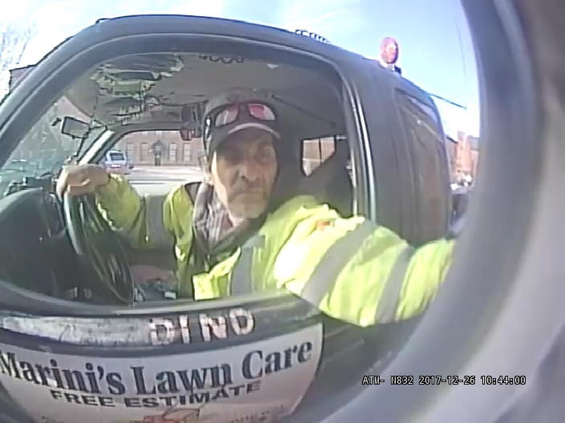

Slide 8
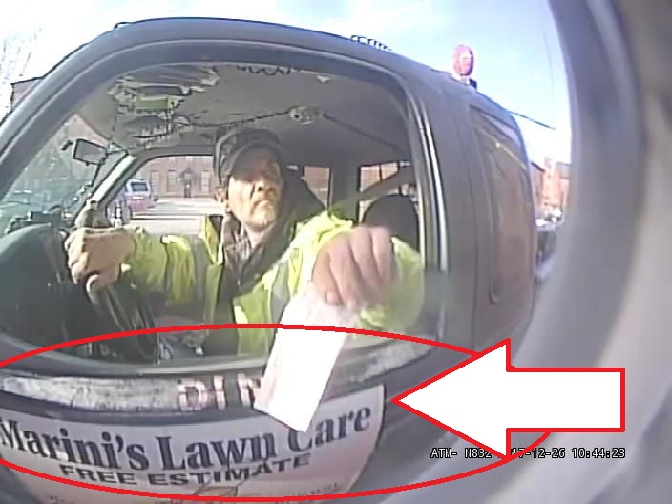

Slide 9
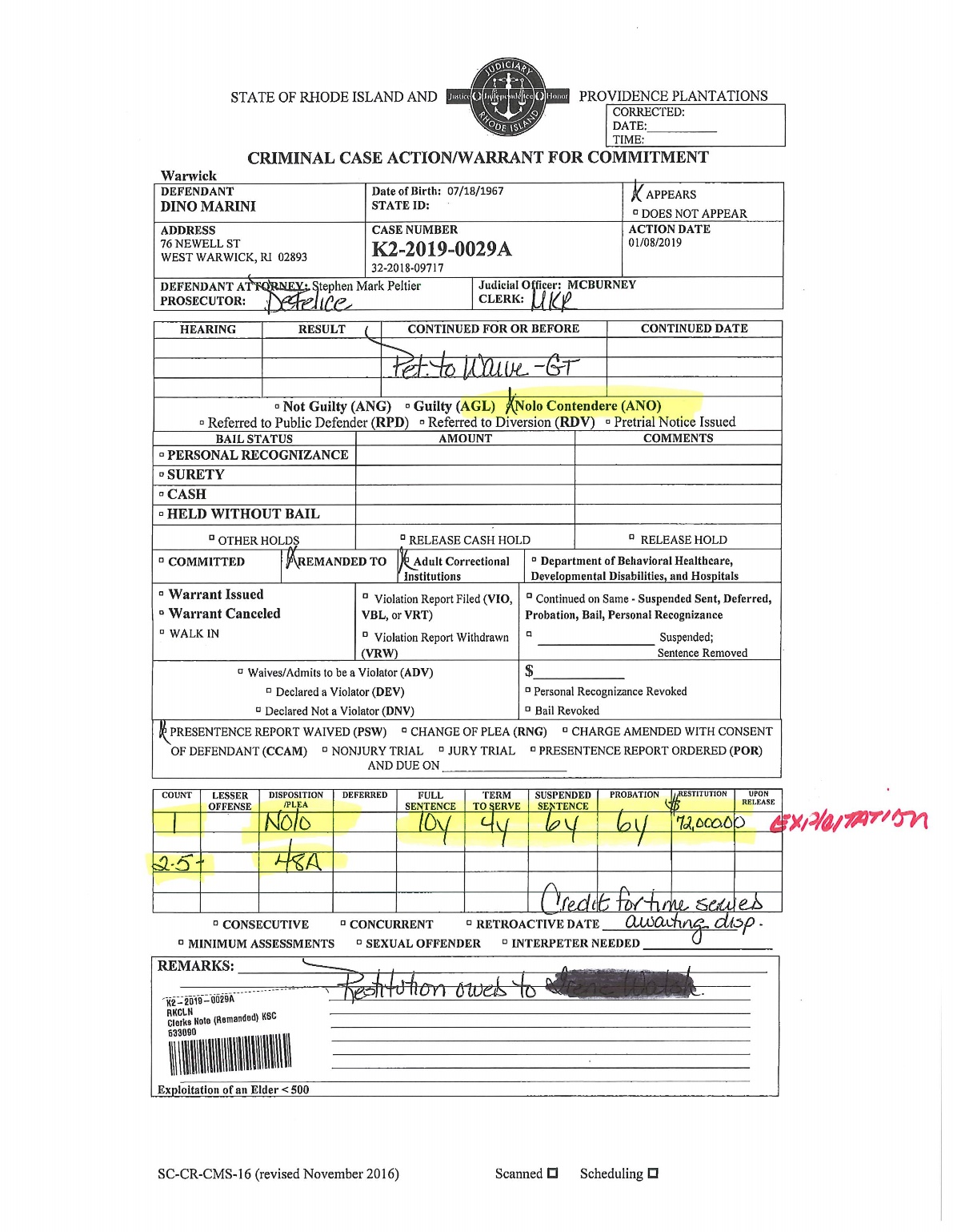

Slide 10
Questions?

